Slide 1
Fog Computing: A Platform for Internet of Things and Analytics
Under The Guidence Of, By,
Supreetha Patel TP, Mohammed Shaiz Ur
KIT, Tiptur Rahaman

Slide 2
Internet of Things(IoT)
Connects internet devices – “things”(tablets, sensors, gateways, mobile-phones) to enable new forms of communication between things and people and between the IoTs themselves
These connections create a network of IoTs
This poses new challenges to the ways things communicate with each other and with people and the way data are manipulated once they are generated at edges of the network
How, what data are transmitted over the network?
When, where data are processed or stored?

Slide 3
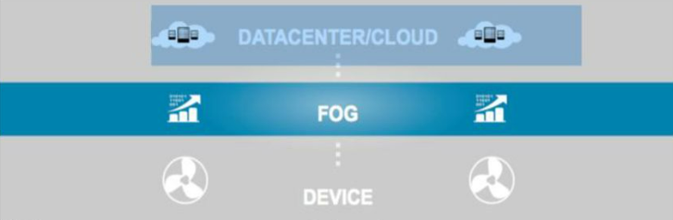
What is It? [Cisco 2015]
Introduced by Cisco, a bridge between IoTs and the Cloud
FOG extends cloud to be closer to things that produce data
Analyze IoT data closer to where its collected so as to minimize latency and processing load on cloud
Any device with computing, storage, network connectivity can be a FOG node
Can be deployed anywhere(Factory floor, vehicle, human body, etc)

Slide 4
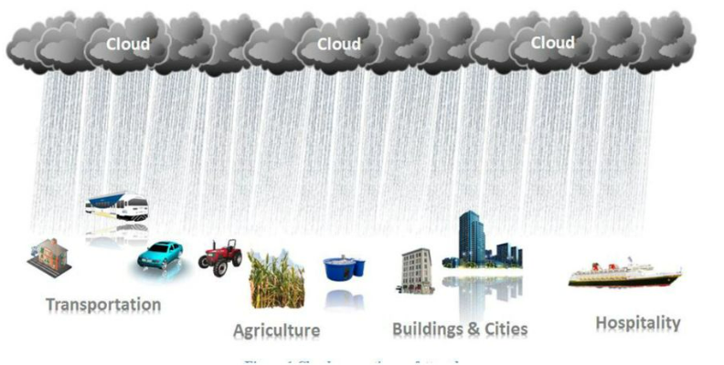
Cloud and IoT: Fog can develop anywhere in-between the two

Slide 5
Why FOG, What it means to Business?
IoT speeds up awareness and response to events
By the time data makes its way to the cloud for analysis, the opportunity to act might be gone
Faster responses can improve output, service quality, safety
Todays cloud models are not always designed for the volume, variety and volume and speed of data
Moving all data to the cloud for analysis would slowdown processing , responses, takes bandwidth and is expensive

Slide 6
More issues
Despite Cloud’s advantages, health care, businesses, government, military organizations and entities that manage sensitive or classified data are reluctant to adopt cloud based solutions due to security risks of transferring data over the Internet
Certain functions are naturally more advantageous to carry out in Fog while others are better suited to cloud
Software To Data Approach: bring software to the data rather than transferring data to the cloud
Transfer analysis results to the cloud
FOG addresses this problem as well

Slide 7
What you get?
Fog filters and analyzes the most time intensive data at the network edge close to where it is generated
Millisecond matter when trying to prevent manufacturing line shutdowns and make the difference between averting disaster and a cascading system failure
Benefits include
Greater business agility, security
Deeper insights, improved privacy
Lower operating cost(bandwidth, storage, processing)
Sends data loads to cloud only for storage and further data analysis(big data analysis)

Slide 8
Application Areas
Smart cities: collect data on city activities e.g. traffic (change signals on surveillance of incoming traffic to prevent accidents or reduce congestion. Data could also be sent to the cloud for longer-term analytics)
Wearable Technology: data from wearable sensors need to be processed locally to inform user and also communicated to the cloud
Wellbeing: monitor environmental conditions in house, health status, in house operations for improving the quality of living especially for elderly, disabled
Industry 4.0: a sensor on a critical machine sends readings associated with imminent failure

Slide 9
What happens in Fog/Cloud?
Fog Nodes: micro data centers at network edge
Like small clouds: cloudlets
Intelligent controllers and gateways collect data from devices
Receive feeds from loTs using a protocol in real-time
Run loT apps for real-time control, context processing, data
analytics
Provide transient storage
Send periodic data summaries to the cloud
The cloud: public, private cloud etc.
Receives and archives data summaries from Fog nodes
Performs data analytics to gain business insight
Can send new application rules to Fog nodes based on these
insights, new business operation plans etc.

Slide 10
Cloud vs FOG [Chiang 2016]
Fog and Cloud will co-exist and work together
FOG will carry-out substantial amount of storage at or near end-user rather than on large scale data center
FOG will carry-out substantial amount of communication at or near the end-user rather than all routed through the backbone network
FOG will carry-our substantial amount of management, control and configuration at or near the end-user rather than on large scale servers
The decision on what functions move to Cloud or keep at FOG nodes is not always easy, depends on application
FOG and Cloud are inter-dependent and mutually beneficial

Slide 11
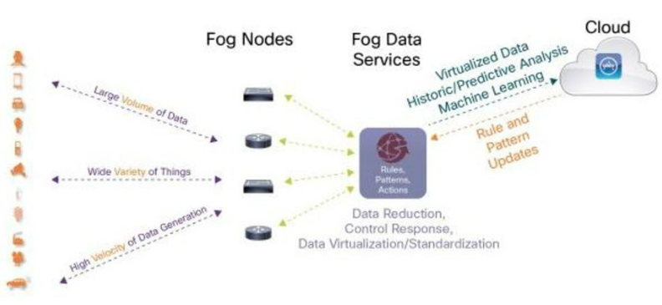
Fog Architecture (by Cisco)

Slide 12
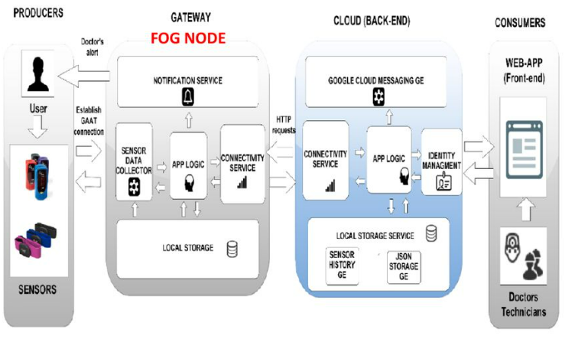
Example Architecture

Slide 13
Security, Privacy and Trust
While FOG may enhance security, it presents new security challenges
User authentication at loTs and gateways is an issue
Each loT has an IP address
Easier to hack FOG nodes and loTs
Malicious users can read/replace/tamper loTs and their readings
(e.g. smart meters installed at consumers house), or use consumer information for profit
In large networks, probably many un-trustworthy users clients don’t trust each other, or are not willing to participate
More issues: Distributed control in a decentralized, mobile crowd of loTs

Slide 14
FOG Reference Architecture (RA)
The means of describing and understanding the requirements of a domain where the architecture applies
Proposed by OpenFog consortium: tech industry, research and academic institutions (est. 2015), still incomplete ...
Fog RA should support at/near end-users
Low latency storage
Computation to avoid latency/network costs
Management, network measurement, control, configuration
Allow analytics results to be securely copied to backend cloud Business deployment

Slide 15
Principles (Pillars) of FOG RA
Security: end-to-end, node and network security
Scalability: nodes, networks, storage and all services are scalable without disrupting system performance
Openness: nodes info and functionality is transparent to applications, nodes can be created anywhere and be discovered / connected / used, while ensuring security/safety/privacy
Autonomy: no single point of failure
Programmability: nodes can be reprogrammed or updated
Reliability: high availability (uptime)
Agility: transform data into actionable insights, quickly respond to changes
Hierarchy: not prerequisite, resources can be seen as a logical hierarchy based on the functional requirements of the loT system

Slide 16
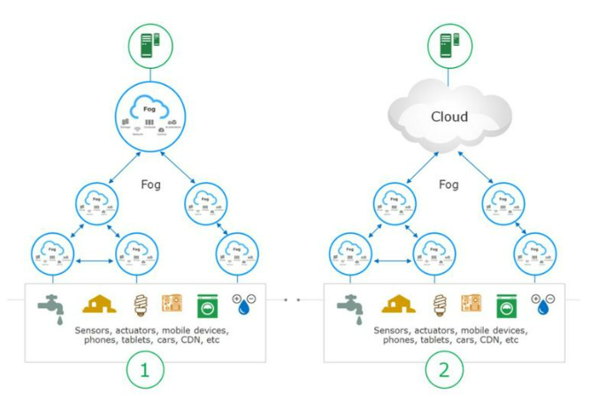
FOG Hierarchy Examples

Slide 17
Examples 1 & 2
Example 1: fog deployment hierarchy independent of the cloud
E.g. the cloud can’t be used due to regulatory compliance, security and privacy reasons, unavailability of a central cloud in an area
armed forces combat systems, drone operations, some healthcare systems, hospitals, and ATM banking systems
Example 2: information processing in fog deployments located close to the infrastructure/process being managed.
commercial building management, commercial solar panel monitoring, cable tv etc.

Slide 18
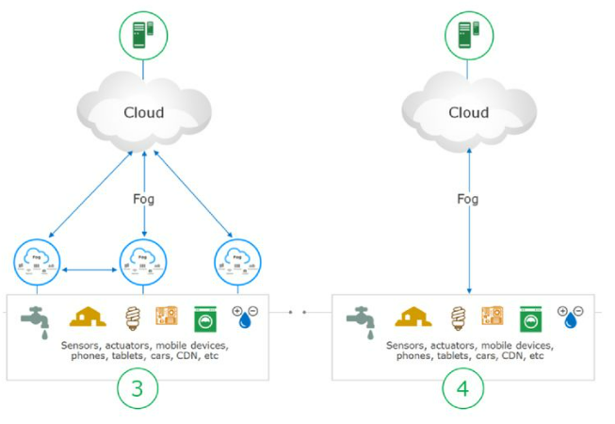
FOG Hierarchy Examples

Slide 19
Examples 3 &4
Example 3: local fog for time-sensitive computation, the cloud is used for operational and business-related information processing
Example 4: constrained environments in which the deployment of fog infrastructure may not be feasible or economical
E.g. Agriculture, whether stations, connected cars

Slide 20
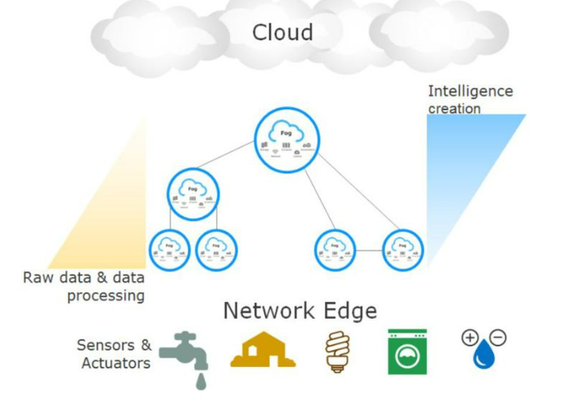
Intelligence in FOG

Slide 21
Node Management
Manageability systems that can survive and manage fog nodes in all power states
Produce reports on the state of fog nodes
Automate discovery, registration and provision of end devices
Gain full understanding of end devices (in terms of their resources, health, operational state)
More manageability aspects: system software and firmware updates, alerts on abnormal operation
Manage events, start/stop, define data flows
Security analysis and response

Slide 22
Physical Node Safety
Perform a security analysis and threat assessmentin order to identify the needs the fog node
Depends also on the location of the fog node and the degree of physical access to it
Apply anti-tamper mechanisms to prevent physical or electronic attacks
Measures: resistance (material), Evidence (prove the event), Detection (e.g. by Sensors), response (countermeasures e.g. clear sensitive data, shutdown or reset).

Slide 23
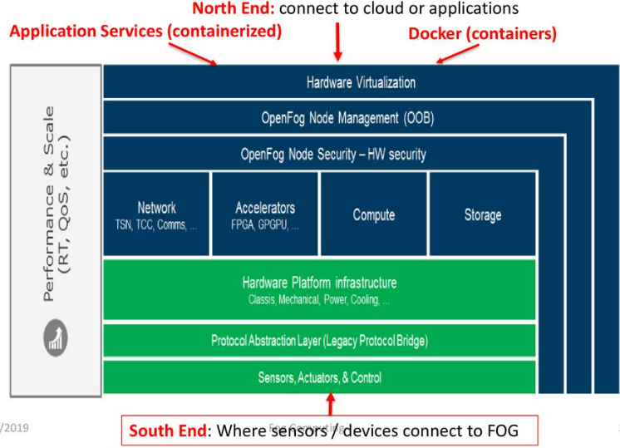
FOG Ref. Architecture Overview

Slide 24
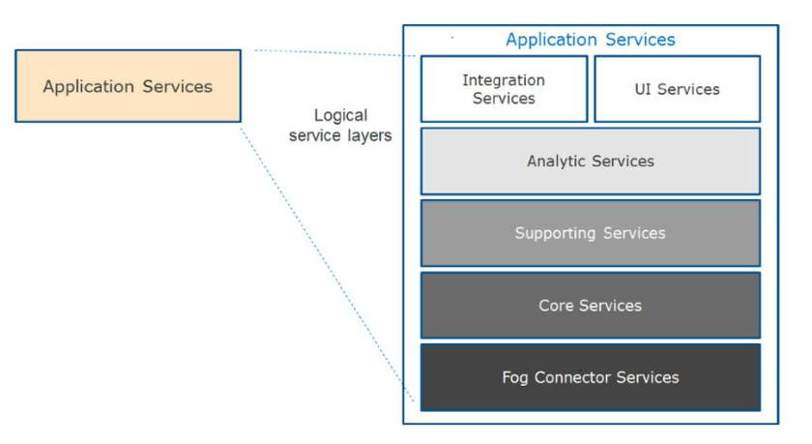
Application-Node Services Layer

Slide 25
Application - Node Services 1/2
May run in virtualized (containerized) environments
Fog connector services: run at the south end, enable connections with Things, support various protocols, translate data to common data structures (e.g. JSON)
Core services: separate the edge device from the application running in Fog node, collect data from the device and make them available to upper level services (e.g. cloud), or pass commands to lower level
Support services: database, event broker, logging, scheduling, service registration, data clean-up etc.

Slide 26
Application - Node Services 2/2
Analytic services: data filtering, averages, machine learning,
local decision (e.g. shutdown when temperature exceeds threshold), anomaly detection (malfunctioning device, intrusion detection)
Application logic services
Integration services: allow outside fog nodes, users or applications to connect
Transform data to desired format (e.g. JSON, XML)
Accepts service requests (e.g. REST to prescribed addresses
User interface: responsible for display and communication with applications and users:
status and operation of fog node, results of analytics processing, interface for node management and probably Web site

Slide 27
References
FOG Computing and the Internet of Things: Extend the Cloud to where the Things Are, Cisco, White Paper, 2015 https://www.cisco.com/c/dam/en_us/solutions/trends/iot/docs/computing-overview.pdf
FOG and loT: An Overview of Research Opportunities, M.Chiang, T.Zhang, 2016 http://ieeexplore.ieee.org/stamp/stamp.jsp?arnumber=7498684
OpenFog Architecture Overview, OpenFog Architecture Working Group, White paper, Feb. 2017, https://www.openfogconsortium.org/wp-content/uploads/OpenFog Reference Architecture 2 0917-FINAL.pdf

Slide 28
Thank You

